Slide 1
Trees

Slide 2
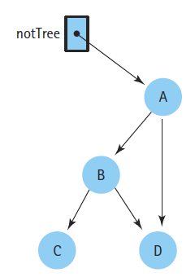
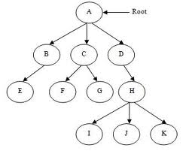
Overview
A tree is a nonlinear hierarchical data structure that consists of nodes connected by edges.
A tree is a graph which does not contain any cycle, hence there is exactly one path from the root node to each node in a tree.

Slide 3
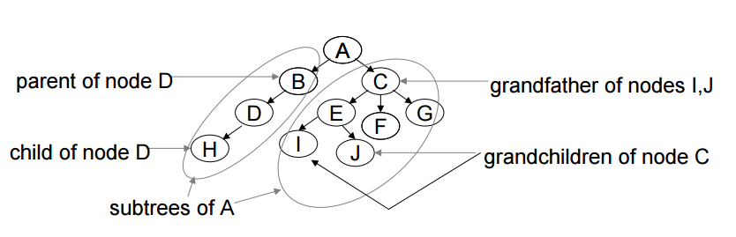
Terminology
Nodes are vertices and Edges are connections between nodes
Root is top most node or base of tree where from tree starts
Parent, Child, Siblings (children of same parent), Grand parent, Grand child
Ancestor – a node A is said to be ancestor of B if A is either parent of B or parent of some
ancestor of B
Descendent – a node B is said to be descendent of A if B is either child of A or child of
some other descendent of A
Leaf node – node with zero child
Sub-tree – Part of tree
Every node except the root has one parent

Slide 4
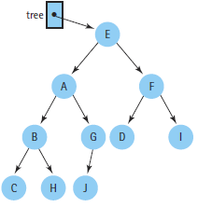
Terminology(Cont…)
Degree of a node is number of nodes connected to it
In a directed tree :
In-degree : Number of edges coming toward to particular node
Out-degree : Number of edges going out from particular node
Internal node – out degree>0
Size of tree: The number of nodes in a tree.

Slide 5
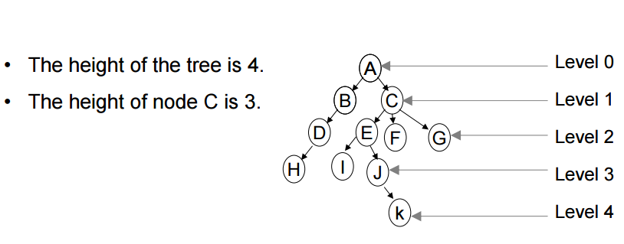
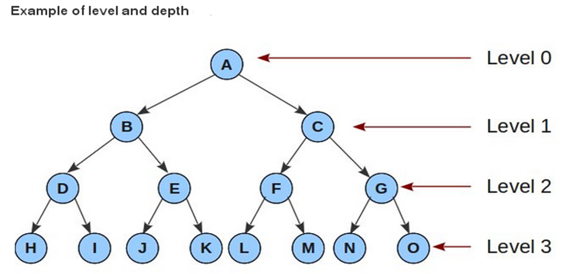
Height and Depth
Height of a node is the length of a longest path from this node to a leaf
All leaves are at height zero
Height of a tree is the height of its root (maximum level)
Depth of a node is the length of path from root to this node
Root is at depth zero
Depth of a tree is the depth of its deepest leaf that is equal to the height of this tree
Depth of this tree is 3

Slide 6
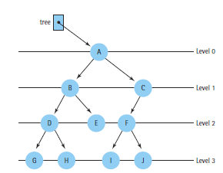
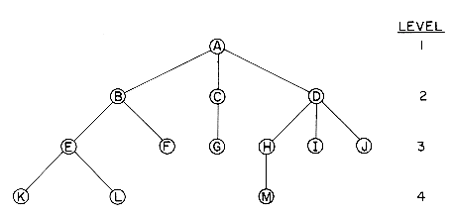
Binary Tree
Tree where each and every node has at most two children
In binary tree the out degree of any node can be 0,1 or 2
Binary tree
Not a binary tree

Slide 7
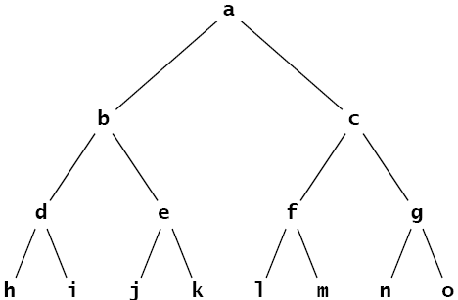
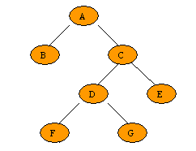
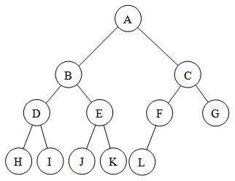
Full Binary Tree
A full binary tree is a binary tree in which every node other than the leaves has two children. This is also called strictly binary tree or proper binary tree or 2-tree.
Is this Full Binary tree
Is this Full Binary tree
Is this Full Binary tree
YES
YES
NO

Slide 8
Some Important Facts
Let T be a nonempty, full binary tree Then:
If T has I internal nodes, the number of leaves L = I + 1.
(b) If T has I internal nodes, the total number of nodes N = 2I + 1.
(c) If T has a total of N nodes, the number of internal nodes I = (N – 1)/2.
(d) If T has a total of N nodes, the number of leaves L = (N + 1)/2.
(e) If T has L leaves, the total number of nodes N = 2L – 1.
(f) If T has L leaves, the number of internal nodes I = L – 1.
Note: the number of nodes N, the number of leaves L, and the number of internal nodes I are related in such a way that if you know any one of them, you can determine the other two.
A full binary tree of height h can have a maximum of 2^{h} leaf nodes, it can have a maximum of 2^{h} – 1 internal nodes.
Maximum nodes in a full binary tree =maximum number of leaves + maximum number of internal nodes =2^{h+1} – 1

Slide 9
Complete Binary Tree
A complete binary tree is a binary tree in which every level, except possibly the last level, is completely filled, and all nodes are as far left as possible.
Is this complete Binary tree
Is this complete Binary tree
Is this complete Binary tree
YES
NO
YES

Slide 10
Complete Binary Tree
Is this complete Binary tree
Is this complete Binary tree
Is this complete Binary tree
YES
YES
But this binary tree is complete. It has only one node, the root.
YES
It is called the empty tree, and it has no nodes, not even a root.

Slide 11
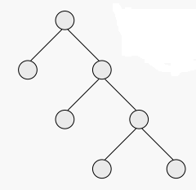
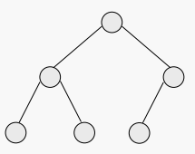
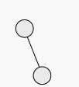
More Examples
Is this Full or complete
Is this Full or complete
Is this Full or complete
Complete but not full
Neither Full nor complete
Full but Not Complete
Perfect binary tree :- Every node except the leaf nodes have two children and every level (last level too) is completely filled. i.e. Perfect binary tree is a binary tree where each level contains the maximum number of nodes
If N is the total nodes in a Perfect binary tree then height (h) = log₂(N+1)-1
Therefore, the total number of nodes in a Perfect binary tree of height h=
2^{h+1} – 1

Slide 12
Skewed tree
Left Skewed Tree Right Skewed Tree
A
A
B
B
C
C
D
D
E
E
Height = N – 1

Slide 13
Representation of binary tree
Binary tree can be represented in two ways –
Array
Linked list
Array Representation –
Three arrays to be maintained.
0
1
2
3
4
5
6
Data
A | B | C | D | E | F | G
A
Left Child
1 | 3 | 4 | -1 | -1 | -1 | -1
B
C
Right Child
2 | -1 | 5 | 6 | -1 | -1 | -1
D
E
F
G

Slide 14
Representation of binary tree (Cont…)
Linked List Representation –
struct TreeNode{
struct node *lc;
int data;
struct node *rc;
};
 | A
A
 | B
 | C
B
C
 | D
 | E
 | F
D
E
F
 | G
G

Slide 15
Operations on Tree
Traversing
Searching
Insertion
Deletion

Slide 16
Traversal
Traversal is the process of visiting every node exactly once
Three recursive techniques for binary tree traversal
Preorder traversal
Inorder traversal
Postorder traversal
Visit the root
Traverse left subtree
Traverse right subtree
Traverse left subtree
Visit the root
Traverse right subtree
Traverse left subtree
Traverse right subtree
Visit the root

Slide 17
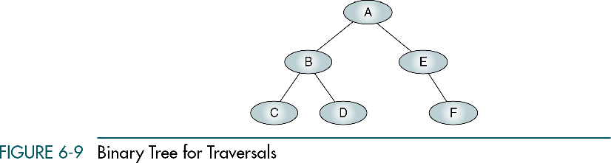
PreOrder (NLR)
Algorithm Preorder (root): Traverse a binary tree in node-left-right sequence.
If (root is not null)
process (root)
Preorder (leftSubtree)
Preorder (rightSubtree)
1. N (node)
2. L (left)
3. R (right)
Preorder – A B C D E F

Slide 18
InOrder (LNR)
Algorithm Inorder (root): Traverse a binary tree in left-node-right sequence.
If (root is not null)
Inorder (leftSubtree)
process (root)
Inorder (rightSubtree)
2. N (node)
1. L (left)
3. R (right)
Inorder – C B D A E F

Slide 19
PostOrder (LRN)
Algorithm Postorder (root): Traverse a binary tree in left-right-node sequence.
If (root is not null)
Postorder (leftSubtree)
Postorder (rightSubtree)
process (root)
3. N (node)
1. L (left)
2. R (right)
Postorder – C D B F E A

Slide 20
Expression Tree
An expression tree is a binary tree with the following properties:
Leaf nodes represent operands
The internal nodes represent operators
Sub trees are sub expressions, with the root being an operator
Example – Infix expression A + (B * C) – D
Note that when expression tree is traversed using:
Inorder it produces infix expression
Preorder it produces prefix expression
Postorder it produces postfix expression
Expression tree
-
+
D
A
*
B
C

Slide 21
Preorder traversal of expression tree
Algorithm Preorder(tree): Print prefix expression for a given expression tree
If (root is not NULL)
print token
Preorder (leftSubtree)
Preorder (rightSubtree)
Prefix expression - + A x B C D
-
+
D
A
x
B
C

Slide 22
Post order traversal of expression tree
Algorithm Postorder(tree): Print postfix expression for a given expression tree
If (root is not NULL)
Postorder (leftSubtree)
Postorder (rightSubtree)
print token
Postfix expression A B C x + D -
-
+
D
A
x
B
C

Slide 23
Inorder traversal of expression tree
Algorithm Inorder(tree): Print infix expression for a given expression tree
If (root is not NULL)
If (token is operand)
print token
else
print left parenthesis
Inorder (leftSubtree)
print token
Inorder (rightSubtree)
print right parenthesis
Infix expression ((A + (B x C)) – D)
-
+
D
A
x
B
C

Slide 24
Exercises
Draw Expression Tree –
1. A + B * C - D / E
2. A * B - ( C + D ) + E
3. A + (B * C – (D / E ↑ F) * G) * H
Postorder Traversal –
1. A B C * + D E / -
2. A B * C D + - E +
3. A B C * D E F ↑ / G * - H * +
Preorder Traversal–
1. - + A * B C / D E
2. + - * A B + C D E
3. + A * - * B C * / D ↑ E F G H

Slide 25
Binary Search Tree (BST)
Binary Search Trees (BST) is a binary tree with following properties –
Every element has a unique key.
The left sub tree of a node contains only nodes with keys less than the node's key.
The right sub tree of a node contains only nodes with keys greater than the node's key.
The left and right sub trees are also binary search trees.
BST are type of binary trees with a special organization of data
This data organization leads to O(log n) complexity for the operations like searching, insertion and deletion etc. in certain types of the BST (height balanced trees).
However, in the worst case it would be O(n).
For getting all advantages of BST, it should be AVL or height balance tree.

Slide 26
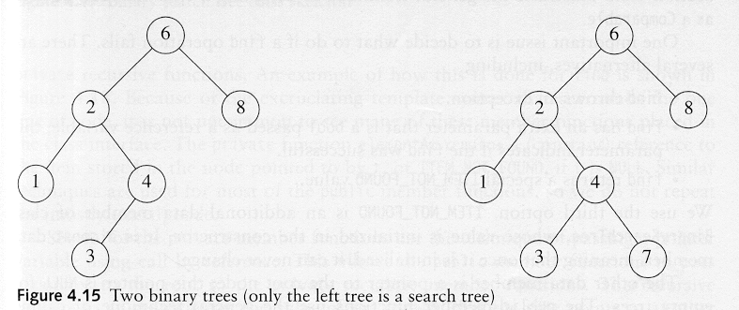
BST Examples
45
G
33
54
E
J
22
47
56
B
H
K
25
A
D
A binary search tree
Not a binary search tree

Slide 27
BST Examples
Two binary search trees representing the same set:

Slide 28
Searching in BST
In the below figure, if we are searching for 15, then we are done.
If we are searching for a key < 15, then we should search in the left subtree.
If we are searching for a key > 15, then we should search in the right subtree.

Slide 29
Searching in BST

Slide 30
Searching a node in BST
Algorithm Search_BST(TreeNode* ROOT, int key, TreeNode** LOC, TreeNode** PAR)
This algorithm searches Key in a BST . This procedure finds the location LOC of Key in tree as well as the parent location PAR of Key , Initially LOC =NULL and PAR=NULL.
Set *LOC =NULL and *PAR=NULL
If ROOT == NULL // Empty Tree
Return
If ROOT->Data == Key // Searched element is found as root node
*LOC = ROOT // Location of searched element
Return
8. Temp = ROOT //Tree has more than one nodes
While (Temp !=NULL)
*PAR = Temp
If ( Key< Temp->Data)
Temp = Temp ->lc
Else
Temp = Temp ->rc
If(Temp!=NULL && Temp->Data == Key)
*LOC = Temp
Break
If LOC == NULL
Print Search Unsuccessful.
//Calling the Algorithm
int key = 40;
TreeNode* LOC;
TreeNode* PAR;
searchBST(ROOT, key, &LOC, &PAR);

Slide 31
Insertion in BST
Algorithm Insert_BST(TreeNode **ROOT, int Key): This algorithm inserts a new leaf node with value Key in BST at appropriate location. ROOT is variable pointing to root of tree. This algorithm uses sub algorithm Search_BST to find the Key location LOC and parent location PAR of Key.
TreeNode* LOC, * PAR
SearchBST(*ROOT, key, &LOC, &PAR)
If LOC != NULL // exit if Key is already present
Print("Key is already present in the tree. Duplicate insert not allowed.”)
Return
Node * New_Node= Allocate memory
New_Node ->Data = Key
New_Node -> lc = NULL
New_Node -> rc = NULL
If *ROOT == NULL // If the tree is empty, set the new node as the root
*ROOT = New_Node
Else If (Key<(PAR->Data) )
PAR->lc = New_Node // make new node a left child of parent
Else
PAR->rc = New_Node // make new node a right child of parent

Slide 32
Deletion in BST
When we delete a node, we need to consider how we handling the children of the deleted node.
This has to be done such that the property of the BST is maintained.
Hence, three cases to be consider for deletion

Slide 33
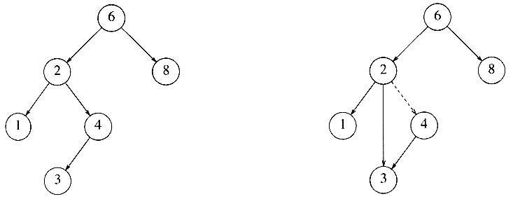
Deletion in BST
Three cases in deletion –Suppose we want to delete a node X from BST,
Case 1: X has no child (i.e. it is a leaf node ), then delete X from tree and make its location in parent node null
Case 2: X has exactly one child, then X will be deleted by replacing the location of X in its parent node by the location of its only child
Case 3: X has two children

Slide 34
Case A (case 1 and case 2)
Algorithm CaseA_delete(TreeNode** ROOT, TreeNode* LOC, TreeNode* PAR) : This algorithm can delete a node having zero on one children. CHILD is a pointer variable pointing to child of node X.
TreeNode* CHILD
If (LOC->lc == NULL)
CHILD= LOC->rc
Else
CHILD= LOC->lc
If (PAR == NULL)
*ROOT = CHILD;
Else
If (LOC == PAR->lc)
PAR->lc = CHILD
Else
PAR->rc = CHILD
free(LOC);

Slide 35
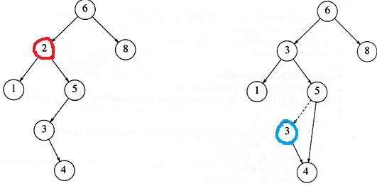
Deletion in BST (case 3)
X has two children
Replace the data value of node X with the minimum element in the right subtree (i.e. replace with in-order successor of X)
Delete in-order successor
Note : in-order successor always has either no child or only right child because if it has a left child, that left child would be smaller and would have been chosen. So invoke case 1 or 2.

Slide 36
Case B (Delete Node which is having two children)
Algorithm CaseB_delete(TreeNode** ROOT, TreeNode* LOC, TreeNode* PAR): This algorithm can delete a node having two children. Inorder_successor is a pointer variable pointing in order successor of node to be deleted.
TreeNode* Temp;
TreeNode* Inorder_successor
TreeNode* Inorder_successor_PAR= LOC
Inorder_successor = LOC->rc
While (Inorder_successor ->lc != NULL) // Find inorder successor
Inorder_successor_PAR = Inorder_successor
Inorder_successor = Inorder_successor ->lc
int Inorder_successor_data = Inorder_successor->Data
CaseA_delete(ROOT, Inorder_successor, Inorder_successor_PAR)
LOC->Data = Inorder_successor_data

Slide 37
Deletion in BST (Cont…)
Algorithm Delete_BST(TreeNode **ROOT, Key): This algorithm deletes a node X with Key from BST. ROOT is variable pointing to root of tree T. This algorithm uses sub algorithm Search_BST to find the Key location LOC and parent location PAR of Key.
TreeNode* LOC, * PAR
SearchBST(ROOT, key, &LOC, &PAR)
If LOC == NULL
print”Node does not exist”
Return
If LOC ->lc !=NULL and LOC ->rc !=NULL // If both children exist
Call CaseB_delete(ROOT, LOC, PAR)
Else
Call CaseA_delete(ROOT, LOC, PAR)

Slide 38
Inorder traversal of BST
Inorder traversal of BST always gives sorted order of the elements
Inorder: 2, 3, 4, 6, 7, 9, 13, 15, 17, 18, 20

Slide 39
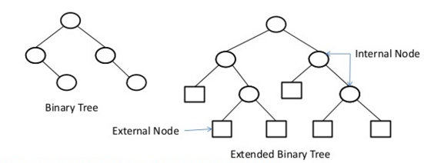
Extended Binary Tree
An extended binary tree is a transformation of any binary tree into a full binary tree.
This transformation consists of replacing every null subtree of the original tree with “special nodes.”
The nodes from the original tree are then become internal nodes, while the “special nodes” are external nodes.

Slide 40
Extended Binary Tree
6
9
4
6
4
9
7
7
7
9
4
6
(B)
(C)
(A)
(A) Total path length of Tree A= 4*2 + 7*3 + 9*3 + 6*1 = 62
(B) Total path length of Tree B= 6*2 + 4*2 + 9*2 + 7*2 = 52
(C) Total path length of Tree C= 7*2 + 4*3 + 6*3 + 9*1 = 53

Slide 41
Huffman Coding Algorithm
An Application of Binary Tree and Priority Queue.
Huffman coding is a lossless data compression algorithm.
In this algorithm, a variable-length code is assigned to different characters.

Slide 42
Huffman Coding : The Basic Idea
Not all the characters occur with the same frequency!
Yet all characters are allocated the same amount of space
1 char = 1 byte, whether it is a or x
In Huffman encoding the basic idea is that instead of storing each character in a file as an 8-bit ASCII value, we will instead store the more frequently occurring characters using fewer bits and less frequently occurring characters using more bits.

Slide 43
Huffman Coding Algorithm
1. Scan text to be compressed and count occurrence of all characters.
2. Sort characters based on number of occurrences in text.
3. Build Huffman code tree based on sorted list using the priority queue.
4. Perform a traversal of tree to determine all code words.
5. Scan text again and create new file using the Huffman codes.

Slide 44
Building a Tree Scan the original text
Consider the following text:
Eerie eyes seen near lake.
Count up the occurrences of all characters in the text

Slide 45
Building a Tree Scan the original text
Eerie eyes seen near lake.
What characters are present?
E e r i space
y s n a r l k .

Slide 46
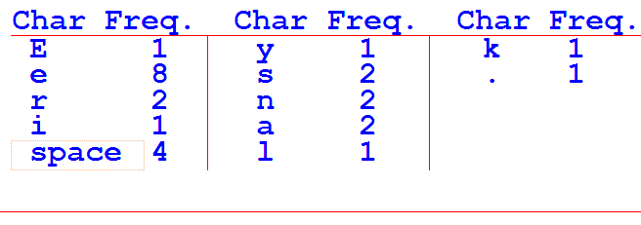
Building a Tree Scan the original text
Eerie eyes seen near lake.
What is the frequency of each character in the text?

Slide 47
Building a Tree Prioritize characters
Create binary tree nodes with character and frequency of each character
Place nodes in a priority queue
The lower the occurrence, the higher the priority in the queue

Slide 48
Building a Tree
While priority queue contains two or more nodes
Create new node
Dequeue node and make it left subtree
Dequeue next node and make it right subtree
Frequency of new node equals sum of frequency of left and right children
Enqueue new node back into queue

Slide 49
Building a Tree
E
1
i
1
y
1
l
1
k
1
.
1
r
2
s
2
n
2
a
2
sp
4
e
8

Slide 50
Building a Tree
y
1
l
1
k
1
.
1
r
2
s
2
n
2
a
2
sp
4
e
8
2
E
1
i
1

Slide 51
Building a Tree
y
1
l
1
k
1
.
1
r
2
s
2
n
2
a
2
2
sp
4
e
8
E
1
i
1

Slide 52
Building a Tree
k
1
.
1
r
2
s
2
n
2
a
2
2
sp
4
e
8
E
1
i
1
2
y
1
l
1

Slide 53
Building a Tree
k
1
.
1
r
2
s
2
n
2
a
2
2
2
sp
4
e
8
y
1
l
1
E
1
i
1

Slide 54
Building a Tree
r
2
s
2
n
2
a
2
2
2
sp
4
e
8
y
1
l
1
E
1
i
1
2
k
1
.
1

Slide 55
Building a Tree
r
2
s
2
n
2
a
2
2
2
sp
4
e
8
2
E
1
i
1
y
1
l
1
k
1
.
1

Slide 56
Building a Tree
n
2
a
2
2
sp
4
e
8
2
2
E
1
i
1
y
1
l
1
k
1
.
1
4
r
2
s
2

Slide 57
Building a Tree
n
2
a
2
2
sp
4
e
8
2
2
4
E
1
i
1
y
1
l
1
k
1
.
1
r
2
s
2

Slide 58
Building a Tree
2
4
e
8
2
2
sp
4
y
1
l
1
k
1
.
1
r
2
s
2
E
1
i
1
4
n
2
a
2

Slide 59
Building a Tree
2
4
4
e
8
2
2
sp
4
y
1
l
1
k
1
.
1
r
2
s
2
n
2
a
2
E
1
i
1

Slide 60
Building a Tree
4
4
e
8
2
sp
4
k
1
.
1
r
2
s
2
n
2
a
2
4
2
2
E
1
i
1
y
1
l
1

Slide 61
Building a Tree
2
4
4
4
sp
4
e
8
2
2
k
1
.
1
r
2
s
2
n
2
a
2
E
1
i
1
y
1
l
1

Slide 62
Building a Tree
4
4
4
e
8
2
2
r
2
s
2
n
2
a
2
E
1
i
1
y
1
l
1
6
2
sp
4
k
1
.
1

Slide 63
Building a Tree
4
4
4
6
e
8
2
sp
4
r
2
s
2
n
2
a
2
2
2
k
1
.
1
E
1
i
1
y
1
l
1

Slide 64
Building a Tree
4
6
e
8
2
2
2
sp
4
E
1
i
1
y
1
l
1
k
1
.
1
8
4
4
r
2
s
2
n
2
a
2

Slide 65
Building a Tree
4
6
e
8
8
2
2
2
sp
4
4
4
E
1
i
1
y
1
l
1
k
1
.
1
r
2
s
2
n
2
a
2

Slide 66
Building a Tree
e
8
8
4
4
10
r
2
s
2
n
2
a
2
4
6
2
2
2
sp
4
E
1
i
1
y
1
l
1
k
1
.
1

Slide 67
Building a Tree
e
8
8
10
4
4
4
6
n
2
a
2
2
2
2
r
2
s
2
sp
4
E
1
i
1
y
1
l
1
k
1
.
1

Slide 68
Building a Tree
10
16
4
6
2
2
2
e
8
8
sp
4
E
1
i
1
y
1
l
1
k
1
.
1
4
4
r
2
s
2
n
2
a
2

Slide 69
Building a Tree
10
16
4
6
e
8
8
2
2
2
sp
4
4
4
E
1
i
1
y
1
l
1
k
1
.
1
r
2
s
2
n
2
a
2

Slide 70
Building a Tree
26
16
10
4
e
8
8
6
2
2
2
sp
4
4
4
E
1
i
1
y
1
l
1
k
1
.
1
r
2
s
2
n
2
a
2

Slide 71
Building a Tree
After enqueueing this node there is only one node left in priority queue.
26
16
10
4
e
8
8
6
2
2
2
sp
4
4
4
E
1
i
1
y
1
l
1
k
1
.
1
r
2
s
2
n
2
a
2

Slide 72
Building a Tree
Dequeue the single node left in the queue.
This tree contains the new code-words for each character.
Frequency of root node should equal number of characters in text.
26
16
10
4
e
8
8
6
2
2
2
4
sp
4
4
E
1
i
1
y
1
l
1
k
1
.
1
r
2
s
2
n
2
a
2
Eerie eyes seen near lake.  26 characters

Slide 73
Encoding the File Traverse Tree for Codes
Perform a traversal of the tree to obtain new code words
Going left is a 0 going right is a 1
code word is only completed when a leaf node is reached
26
16
10
4
e
8
8
6
2
2
2
4
sp
4
4
E
1
i
1
y
1
l
1
k
1
.
1
r
2
s
2
n
2
a
2

Slide 74
Encoding the File Traverse Tree for Codes
Char Code
E 0000
i 0001
y 0010
l 0011
k 0100
. 0101
space 011
e 10
r 1100
s 1101
n 1110
a 1111
26
16
10
4
e
8
8
6
2
2
2
4
sp
4
4
E
1
i
1
y
1
l
1
k
1
.
1
r
2
s
2
n
2
a
2

Slide 75
Encoding the File Results
Have we made things any better?
73 bits to encode the text
ASCII would take 8 * 26 = 208 bits
0000101100000110011100010101101101001111101011111100011001111110100100101

Slide 76
Decoding the File
How does receiver know what the codes are?
Tree constructed for each text file are then saved as a header in the compressed file
Doesn’t add a significant amount of size to the file for large files (which are the ones you want to compress anyway)

Slide 77
Decoding the File
Once the receiver has Huffman coding tree, the compressed text can be decoded as:
Read bit stream from left to right and traverse tree from root to leaf
For 0 ⇒ go left
For 1 ⇒ go right
Print character
26
16
10
4
e
8
8
6
2
2
2
4
sp
4
4
E
1
i
1
y
1
l
1
k
1
.
1
r
2
s
2
n
2
a
2
010011000001110111101111011110100011100
krisna sir

Slide 78
Important Facts:
It is an example of a greedy algorithm: It's called greedy because the two smallest nodes are chosen at each step, and this local decision results in a globally optimal encoding tree.
Huffman tree is an optimal tree: there are no other trees with the same characters that use fewer bits to encode the same string.
Huffman codes are prefix free codes (prefix codes) i.e. the codes (bit sequences) are assigned in such a way that the code assigned to one character is not prefix of code assigned to any other character. This is how Huffman Coding makes sure that there is no ambiguity when decoding the generated bit stream.
Huffman coding is used to assign variable size code for symbol. In Huffman coding, less size code is assigned to frequently occurring symbols and large size code is assigned to rarely occurring symbols.

Slide 79
Huffman Tree
Let following information is given –
Letter
A | B | C | D | E | F | G
16 | 11 | 7 | 20 | 25 | 5 | 16
Frequency
100
43
57
20
23
25
32
11
12
16
16
5
7

Slide 80
Application of Huffman Tree
Huffman tree is used to compress the text(message) if we want to send a message on network.
JPEG image format uses Huffman algorithm for compression.
GZIP, PKZIP (winzip etc) and BZIP2,
Image format PNG also uses Huffman coding
used in Video format MPEG

Slide 81
Exercise
Draw the huffman tree and find the codes for the following statements –
the quick brown fox jumps over the lazy dog
Eerie eye seen near the lake.
A cat may look at a king
Fortune favours the brave

Slide 82
Binary Tree from given inorder and preorder sequence
Method:
Step 1: To find the root node we select leftmost element in a preorder sequence, let say this node is X.
Step 2: Search this node X in Inorder sequence, all elements coming to the left side of X are the part of left subtree and elements on right are the part of right subtree.
Step 3: Repeat step1 and 2 recursively for each and every node .
Example :Construct a binary tree for the following pre-order and in-order traversals:
In-order sequence: DIBHJEAFLKCGM
Pre-order sequence: ABDIEHJCFKLGM

Slide 83
AVL Tree
AVL Tree is invented by GM Adelson - Velsky and EM Landis in 1962.
The tree is named AVL in honour of its inventors.
AVL Tree can be defined as height balanced binary search tree in which each node is associated with a balance factor which is calculated by subtracting the height of its right sub-tree from that of its left sub-tree.
Tree is said to be balanced if balance factor of each node is in between -1 to 1, otherwise, the tree will be unbalanced tree and need to be balanced.
Balance Factor (k) = height (left(k)) - height (right(k))
If balance factor of any node is 0, it means that the left sub-tree and right sub-tree contain equal height.

Slide 84
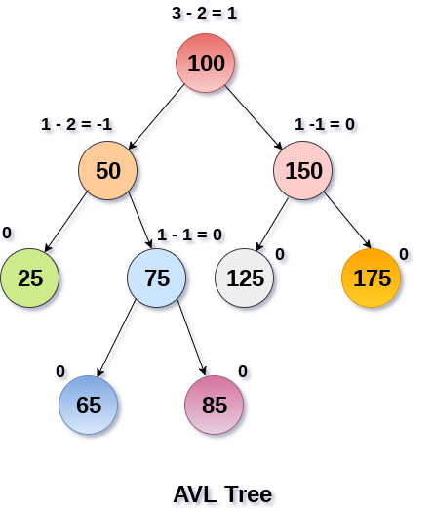
AVL Tree
If balance factor of any node is -1, it means that the left sub-tree is one level lower than the right sub-tree.

Slide 85
Why AVL Tree?
Most of the BST operations (e.g., search, max, min, insert, delete.. etc) take O(h) time where h is the height of the BST.
The cost of these operations may become O(n) for a skewed Binary tree. If we make sure that the height of the tree remains O(log(n)) after every insertion and deletion, then we can guarantee an upper bound of O(log(n)) for all these operations.
The height of an AVL tree is always O(log(n)) where n is the number of nodes in the tree.

